Slide 1
The following is a sequence of Redo-log records written by two transactions T and U:
<Start T>; <T, A, 10>; <Start U>; <U, B, 20>; <T, C, 30>; <U, D, 40>;
<Commit U>; <T, E, 50>; <Commit T>
(a) ➔Crash and the last log record on disk <T, C, 30> ??
Neither T nor U have <Commit> log record on disk
Do Nothing.

Slide 2
The following is a sequence of Redo-log records written by two transactions T and U:
<Start T>; <T, A, 10>; <Start U>; <U, B, 20>; <T, C, 30>; <U, D, 40>;
<Commit U>; <T, E, 50>; <Commit T>
(b) ➔Crash and the last log record on disk <T, E, 50> ??
U has <Commit> log record on disk
Redo U
  Set B = 20
  Set D = 40
  Add <End U> to the log and flush to disk

Slide 3
The following is a sequence of Redo-log records written by two transactions T and U:
<Start T>; <T, A, 10>; <Start U>; <U, B, 20>; <T, C, 30>; <U, D, 40>;
<Commit U>; <T, E, 50>; <Commit T>, <End U>
(c) ➔Crash and the last log record on disk <End U> ??
U has <End> log record on disk, so skip it ➔ its data are on disk
T has <Commit> log record on disk, so redo T
  Set A = 10
  Set C = 30
  Set E = 50
  Add <End T> to the log and flush to disk

Slide 4
Build the Precedence Graph P(S) for
S = w3(A) w2(C) r1(A) w1(B) r1(C) w2(A) r4(A) w4(D)
Is S conflict-serializable?
No
T1
T2
T4
T3

Slide 5
State whether or not each transaction is “Well-Formed” ?
State whether or not the schedule is “Legal”?
Transaction 1: Well-Formed //focus only in Transaction 1’s action
Transaction 2: Well-Formed //focus only in Transaction 2’s action
Transaction 3: Well-Formed //focus only in Transaction 3’s action
Schedule is NOT Legal “l1(B)………l2(B)”

Slide 6
Undo/Redo Logging Exercise
Solve 17.4.3 & 17.4.4 in Textbook (Page 874)
<Start T>, <T,A, 10, 11>, <Start U>, <U,B, 20, 21>, <T, C, 30, 31>, <U, D, 40, 41>, < Commit U>, < T, E, 50, 51>, <Commit T>
Crash after <Start U> written to disk
Crash after < T, E, 50, 51> written to disk

Slide 7
Undo/Redo Logging Exercise
Solve 17.4.3 & 17.4.4 in Textbook (Page 874)
<Start T>, <T,A, 10, 11>, <Start U>, <U,B, 20, 21>, <T, C, 30, 31>, <U, D, 40, 41>,
< Commit U>, < T, E, 50, 51>, <Commit T>
Crash after <Start U> written to disk
Need to undo both transactions. // move backward, and use the old values
Undo U ➔ Nothing to be done
Undo T ➔ Set A = 10

Slide 8
Undo/Redo Logging Exercise
Solve 17.4.3 & 17.4.4 in Textbook (Page 874)
<Start T>, <T,A, 10, 11>, <Start U>, <U,B, 20, 21>, <T, C, 30, 31>, <U, D, 40, 41>,
< Commit U>, < T, E, 50, 51>, <Commit T>
(b) Crash after < T, E, 50, 51> written to disk
Need to undo T and redo U
Undo T // move backward, and use the old values
➔Set E = 50
➔Set C = 30
➔Set A = 10
Redo U // move forward, and use the new values
➔ Set B = 21
➔ Set D = 41

Slide 9
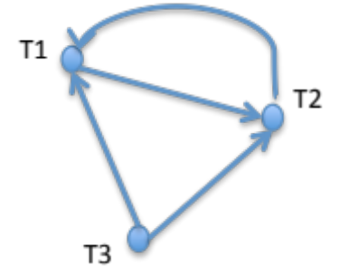
Q1: Draw the precedence graph for the schedule.
Q2: Is the schedule conflict-serializable? If yes, write down a possible equivalent serial schedule. If not, explain why not.
S1: r1(A), r1(B), r2(A), w3(C), w2(B), w2(C), w1(C)
Not conflict-serializable

Slide 10
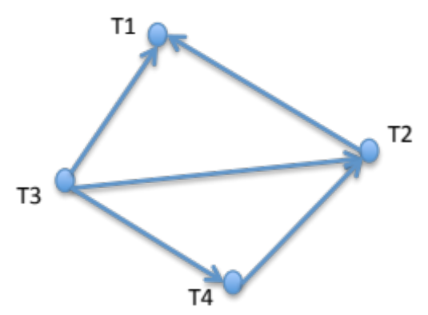
Q1: Draw the precedence graph for the schedule.
Q2: Is the schedule conflict-serializable? If yes, write down a possible equivalent serial schedule. If not, explain why not.
S2: w3(A), w2(C), r1(A), w1(B), r1(C), r2(A), r4(A), w4(D), r2(D))
It is Conflict-Serializable.
One possible schedule:
T3, T4, T2, T1

Slide 11
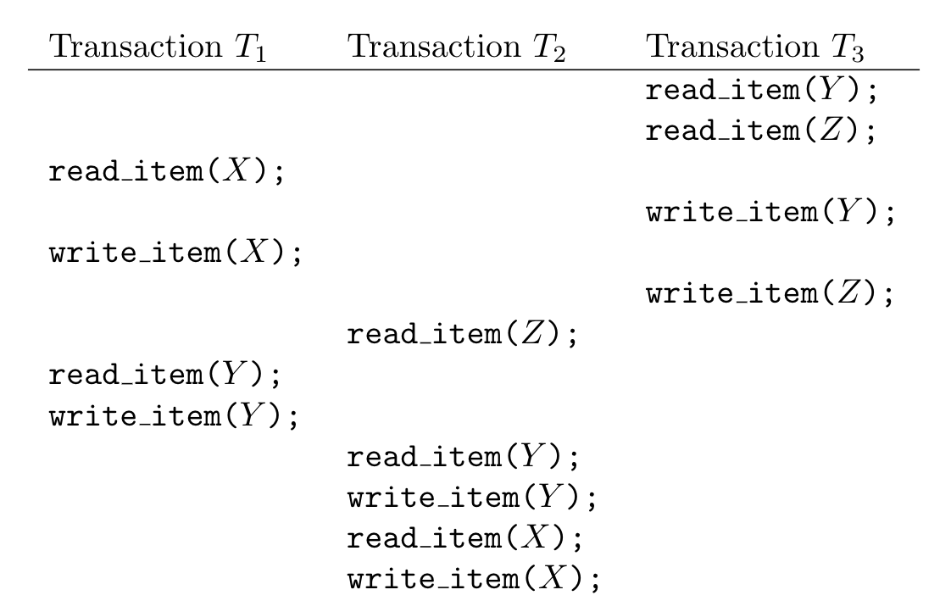
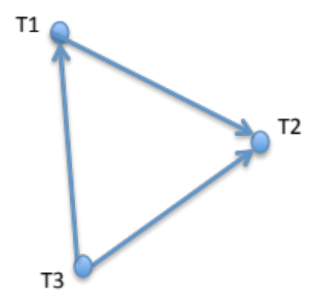
Q1: Draw the precedence graph for the schedule.
Q2: Is the schedule conflict-serializable? If yes, write down a possible equivalent serial schedule. If not, explain why not.
Conflict-Serializable.
One possible schedule:
T3, T2, T1

Slide 12
For each of the following schedules, state whether or not the schedule is legal, and discuss why.
S1 = l1(A) l1(B) r1(A) w1(B) l2(B) u1(A) u1(B) r2(B) w2(B) u2(B) l3(B) r3(B) u3(B)
>>> Not legal because T2 gets a lock on B (action 5) while T1 still holds its lock (action 2)
S2 = l1(A) r1(A) w1(B) u1(A) u1(B) l2(B) r2(B) w2(B) l3(B) r3(B) u3(B)
>>> Not legal because T1 unlocks B (action 5) while it does not have a lock on this object

Slide 13
State whether or not Transaction 1 in each of the above schedules is Well-Formed. Discuss why?
S1 = l1(A) l1(B) r1(A) w1(B) l2(B) u1(A) u1(B) r2(B) w2(B) u2(B) l3(B) r3(B) u3(B)
S1 = l1(A) l1(B) r1(A) w1(B) u1(A) u1(B) ➔ T1 is well formed
S2 = l1(A) r1(A) w1(B) u1(A) u1(B) l2(B) r2(B) w2(B) l3(B) r3(B) u3(B)
S2 = l1(A) r1(A) w1(B) u1(A) u1(B) ➔ T1 is not well formed because it unlocks B without locking it

Slide 14
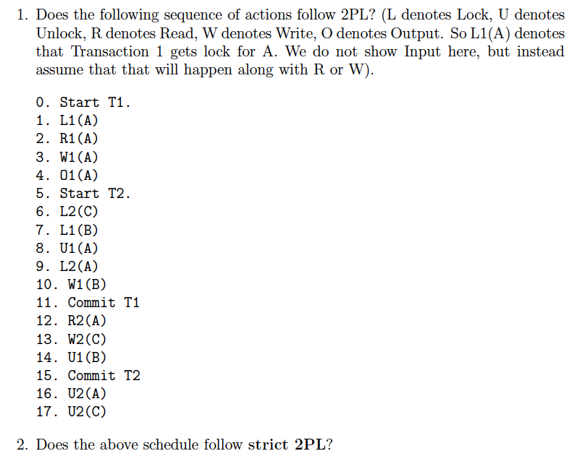
>> It follows the 2PL rules since no transaction creates new locks after the first unlock

